Slide 1
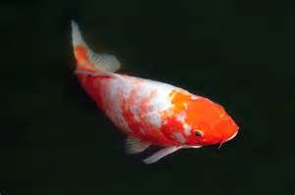
Koi Fish Painting

Slide 2
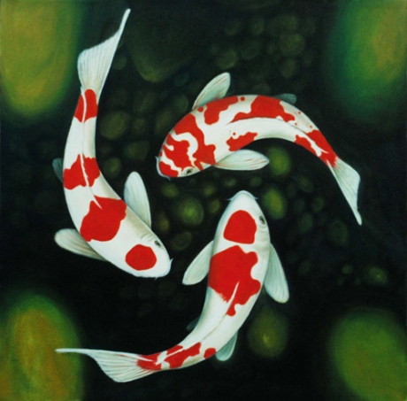
Koi are sometimes Japanese Goldfish, But Koi history goes back to South China as far as 20 million years ago.

Slide 3
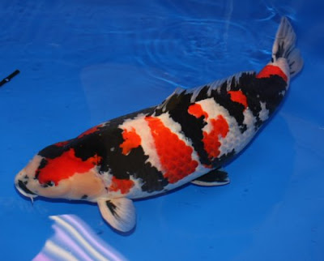
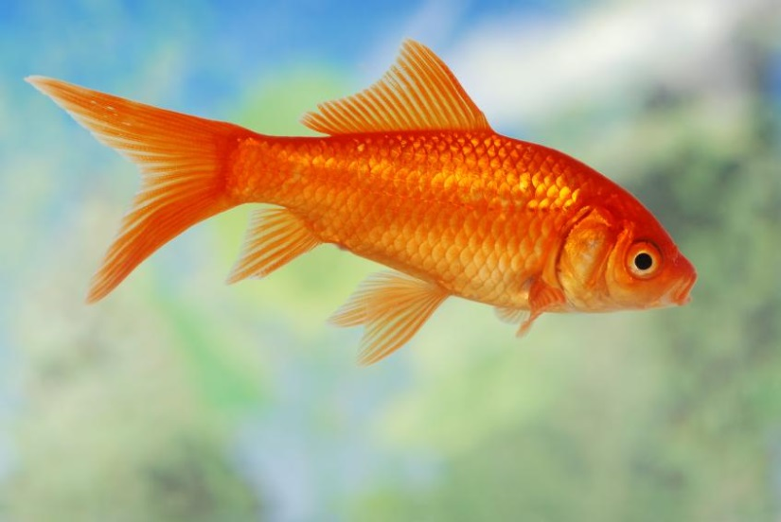
Koi and goldfish are both types of carp but come from 2 different families

Slide 4
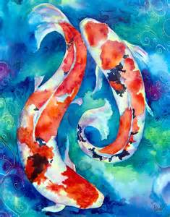
Fish in China are a symbol of wealth, abundance, harmony, marital happiness

Slide 5
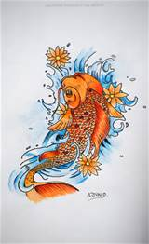
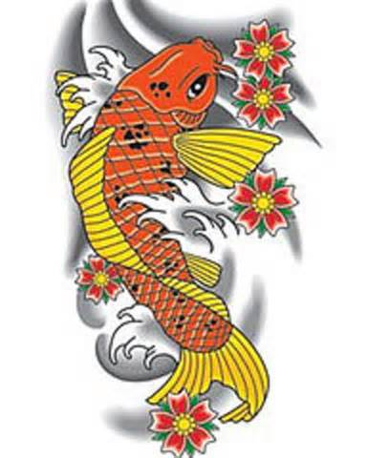
The most popular image or symbol of fish in China is the Koi or Carp.

Slide 6
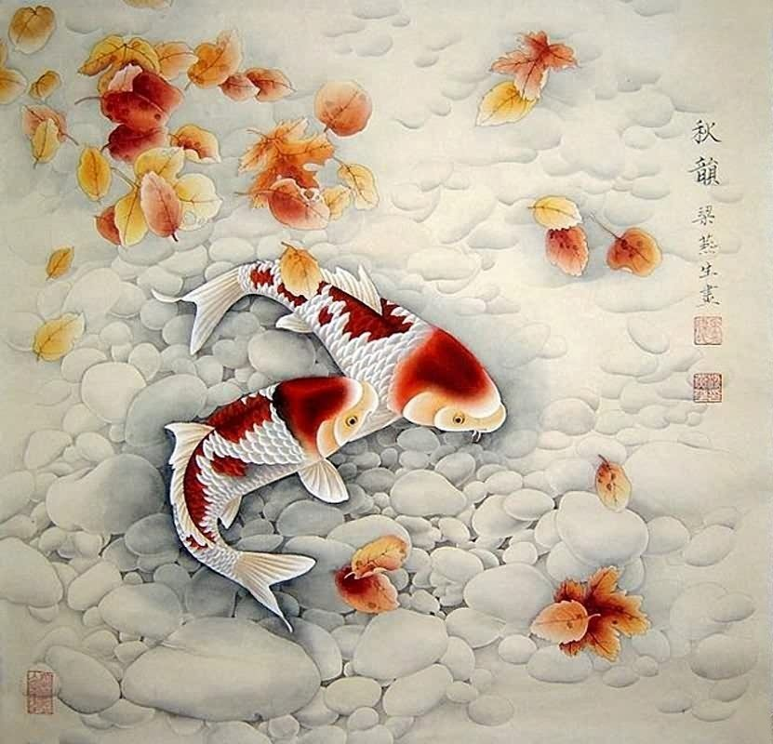
It stands for strength and perseverance.

Slide 7
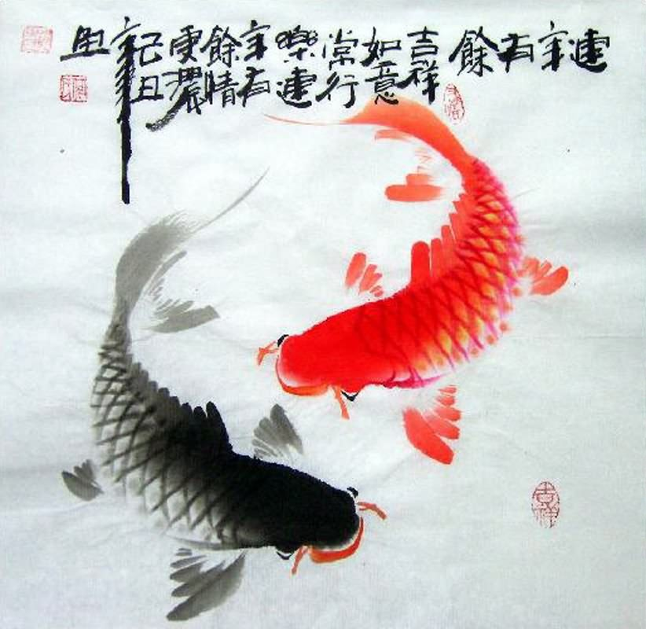
They believed that the Koi would swim upstream of the mighty Yellow river, climb the waterfall and enter the Dragon Gate where they would become dragons

Slide 8
All fisherman like to tell their story, even better to have a picture. Japanese fishermen were no different. Two-hundred years ago they began to record their catches of Koi with what are now the early forms of Koi fish art

Slide 9
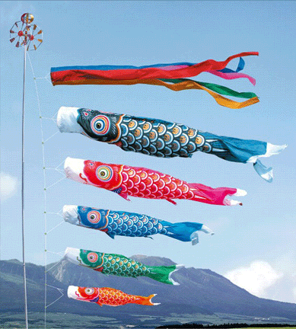
The Koi symbol is often found on large flags flown on Boy's Day to celebrate the energy and power that every boy should have.

Slide 10
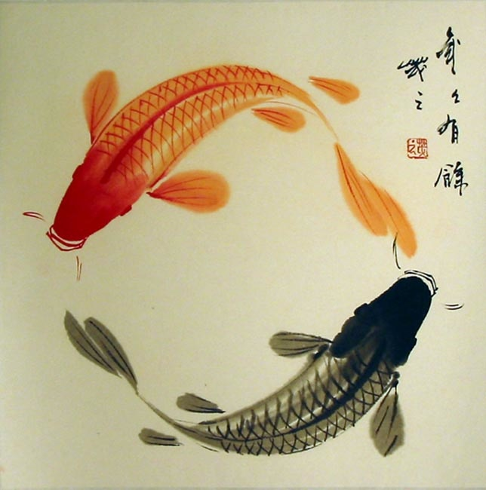

Slide 11
